Slide 1
Color VDT
advanced training
May 2022

Slide 2
Agenda slide
Mobile registration/vaccination
Applications of secondary calendars
Registration Deep Dive
Retroactively entering registration and vaccination data
Scribe Feature

Slide 3
01
Mobile registration/
vaccination

Slide 4

Reasons for mobile registration/
vaccination
Clinic conducts vaccinations of homebound individuals where it does not make sense to bring a laptop/tablet
Clinic does not have access to laptops/tablets onsite
Proprietary and Confidential — Not for distribution.

Slide 5

Using mobile registration
Works in the same way as laptop/tablet registration
To vaccinate homebound patients, you can use the “Add patient” functionality

Slide 6
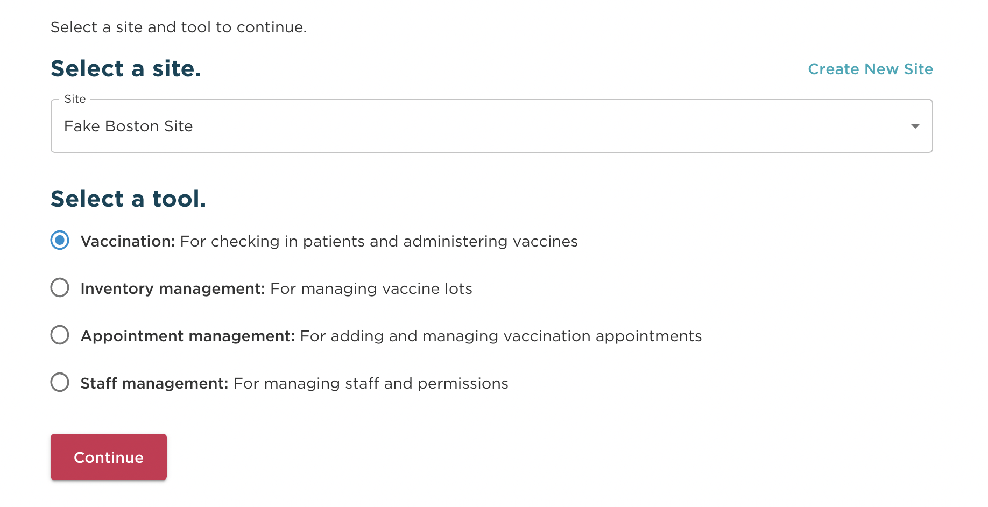
Adding a patient
Select the vaccination tool within the Onsite tool

Slide 7
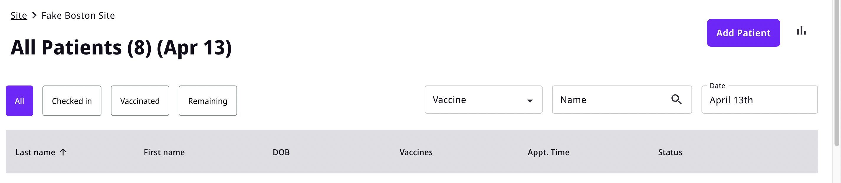
Adding a patient
Adding a patient: click on add patient
Selecting the “Add Patient” link will initiate the process for adding a new patient.
This will not pull from scheduled appointments.

Slide 8
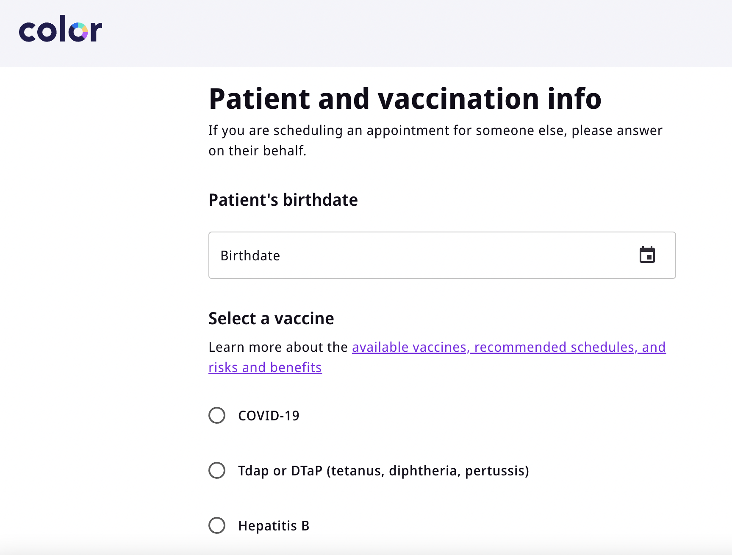
Adding a patient
Adding a patient: collect patient information
Collect required patient information.

Slide 9
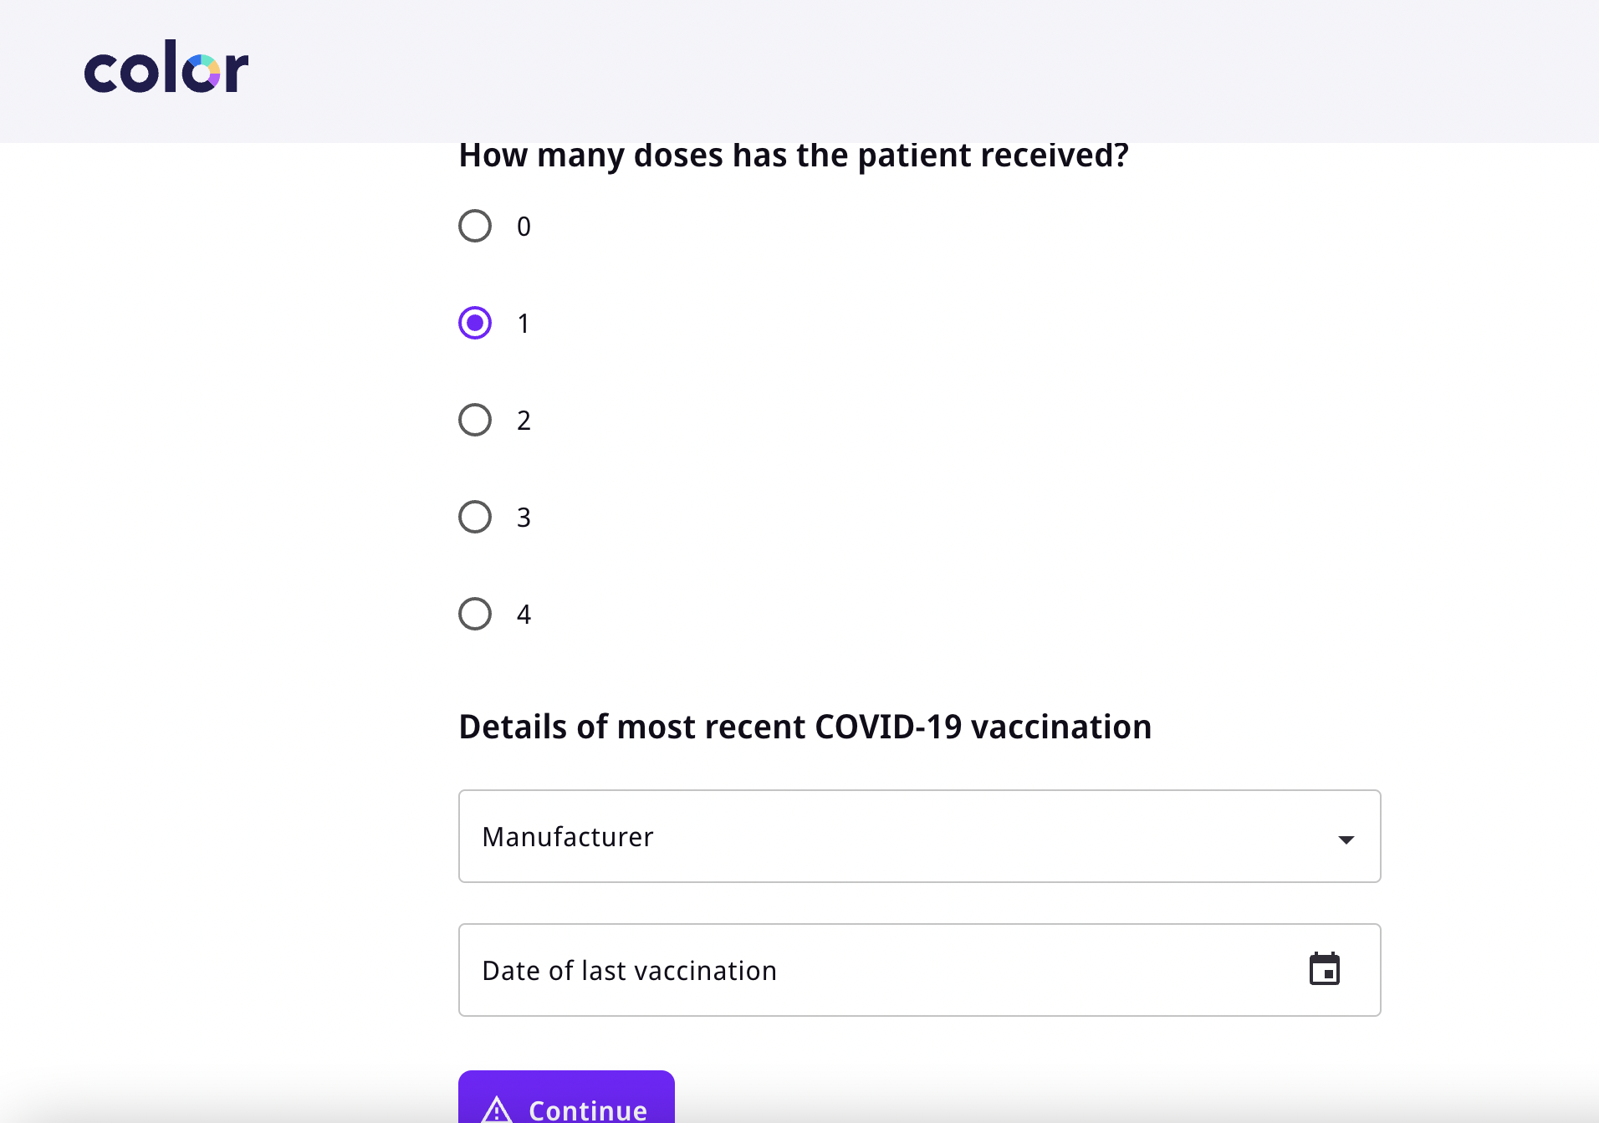
Adding a patient
Adding a patient: provide vaccination history
If patient has had a previous vaccination, ask them for the manufacturer and dose.
If the patient hasn’t waited an appropriate number of days since their previous dose, the system will show they are not eligible.

Slide 10
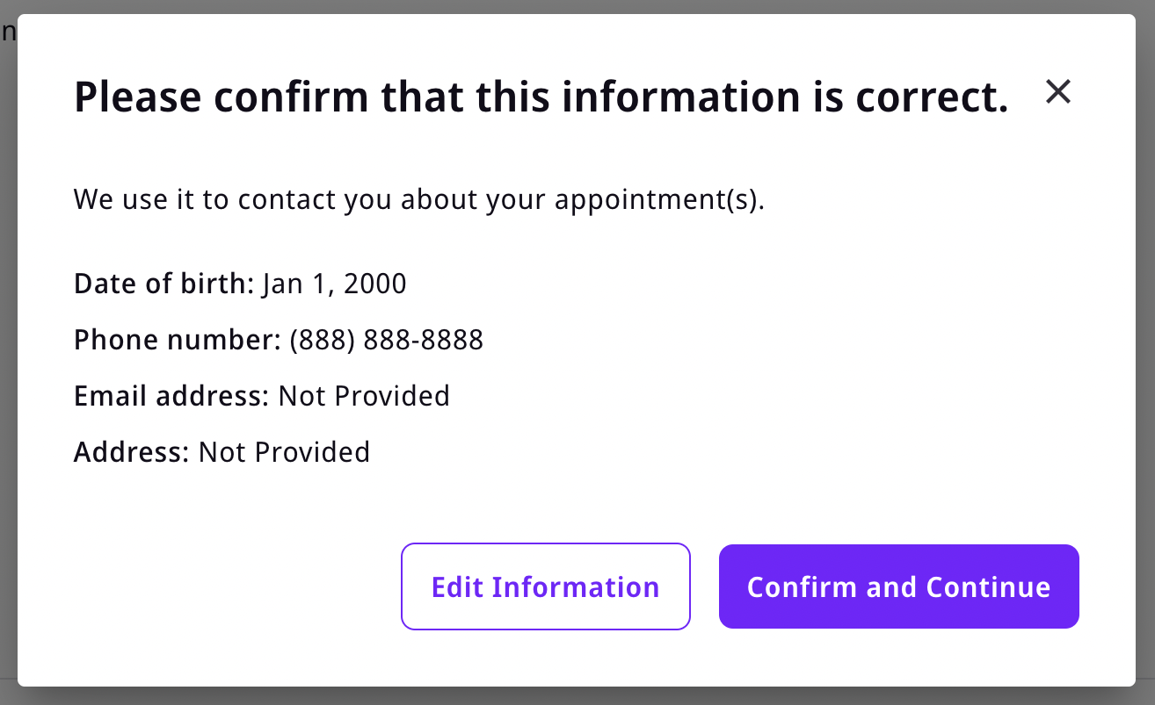
Adding a patient
Adding a patient: confirm patient contact information
Make sure the information entered is correct, as contact info and DOB will be used for scheduling reminders and access to booking their second dose appointment.

Slide 11
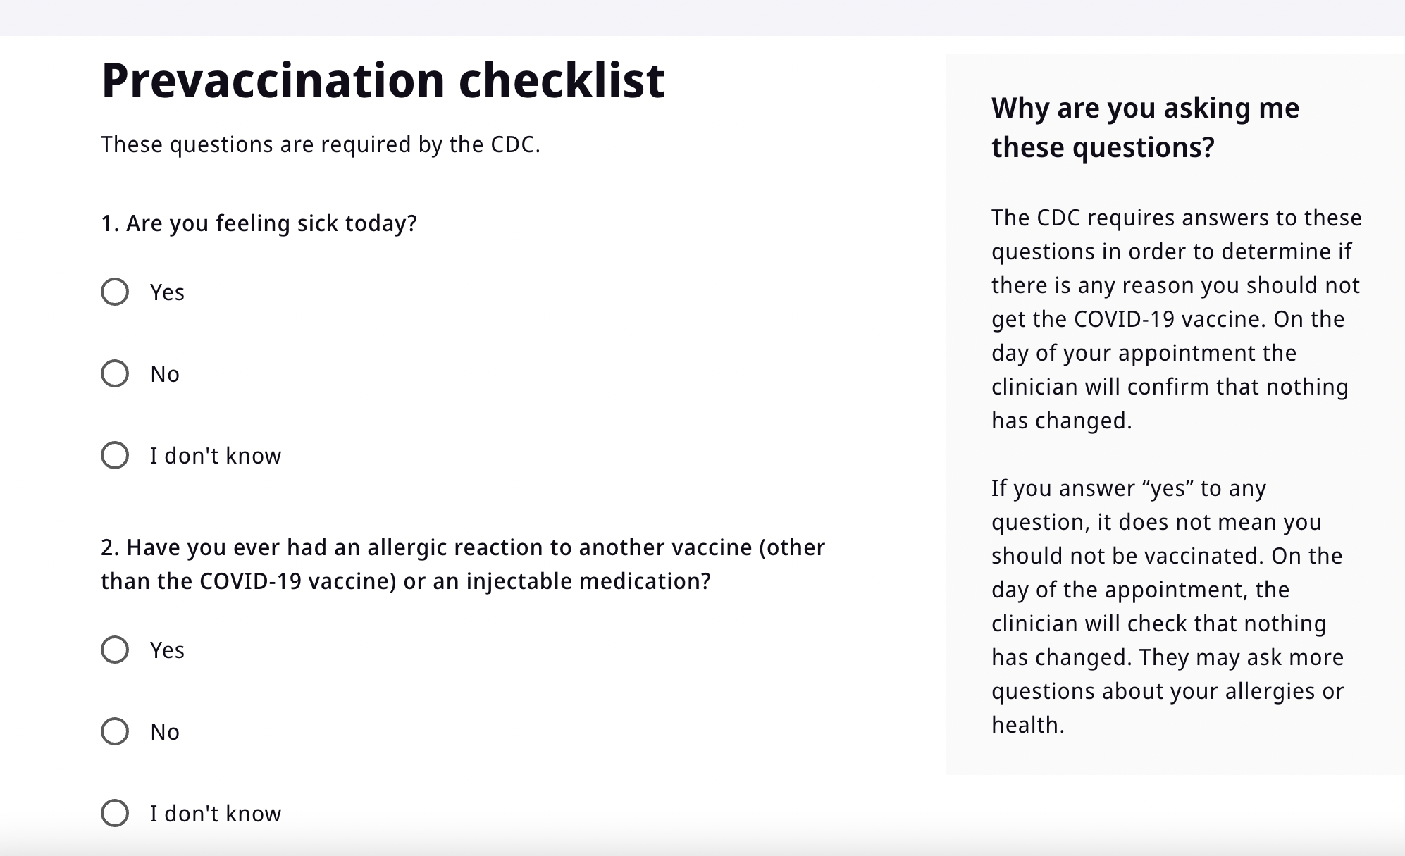
Adding a patient
Adding a patient: complete the prevaccination checklist with the patient

Slide 12
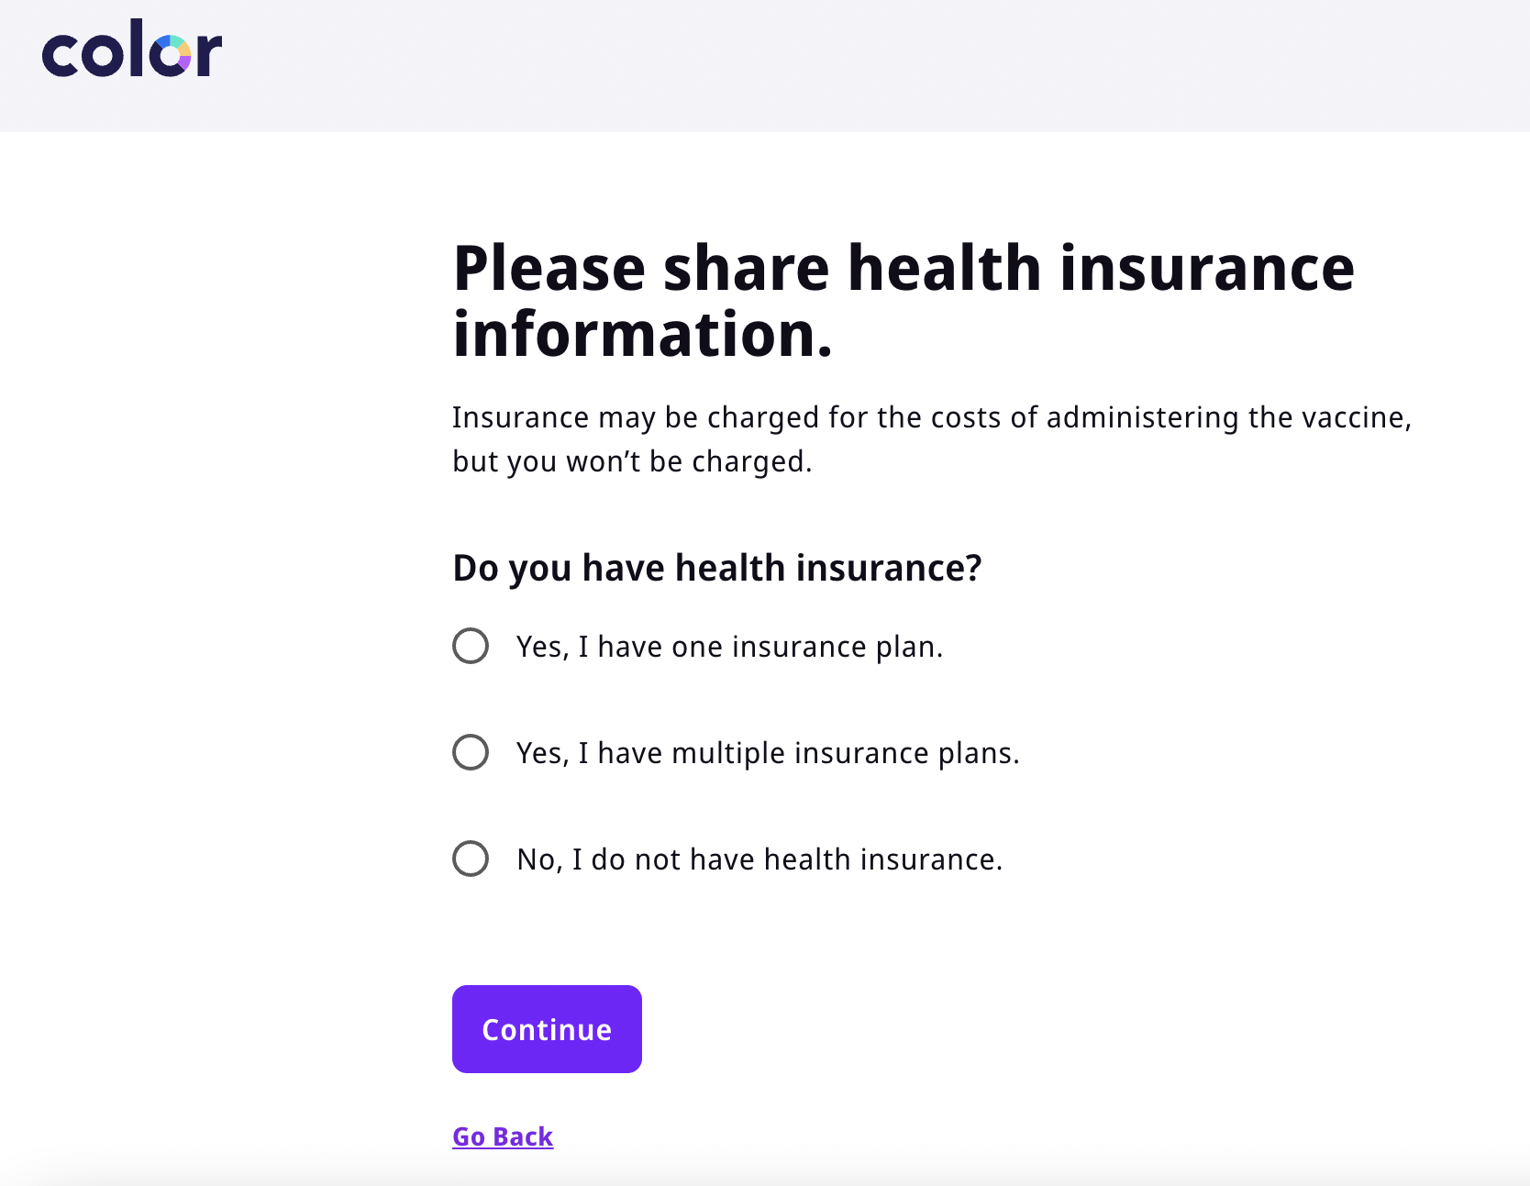
Adding a patient
Adding a patient: Collect their health insurance
Patients have the ability to add a primary and secondary insurance with “Yes, I have multiple insurance plans”

Slide 13
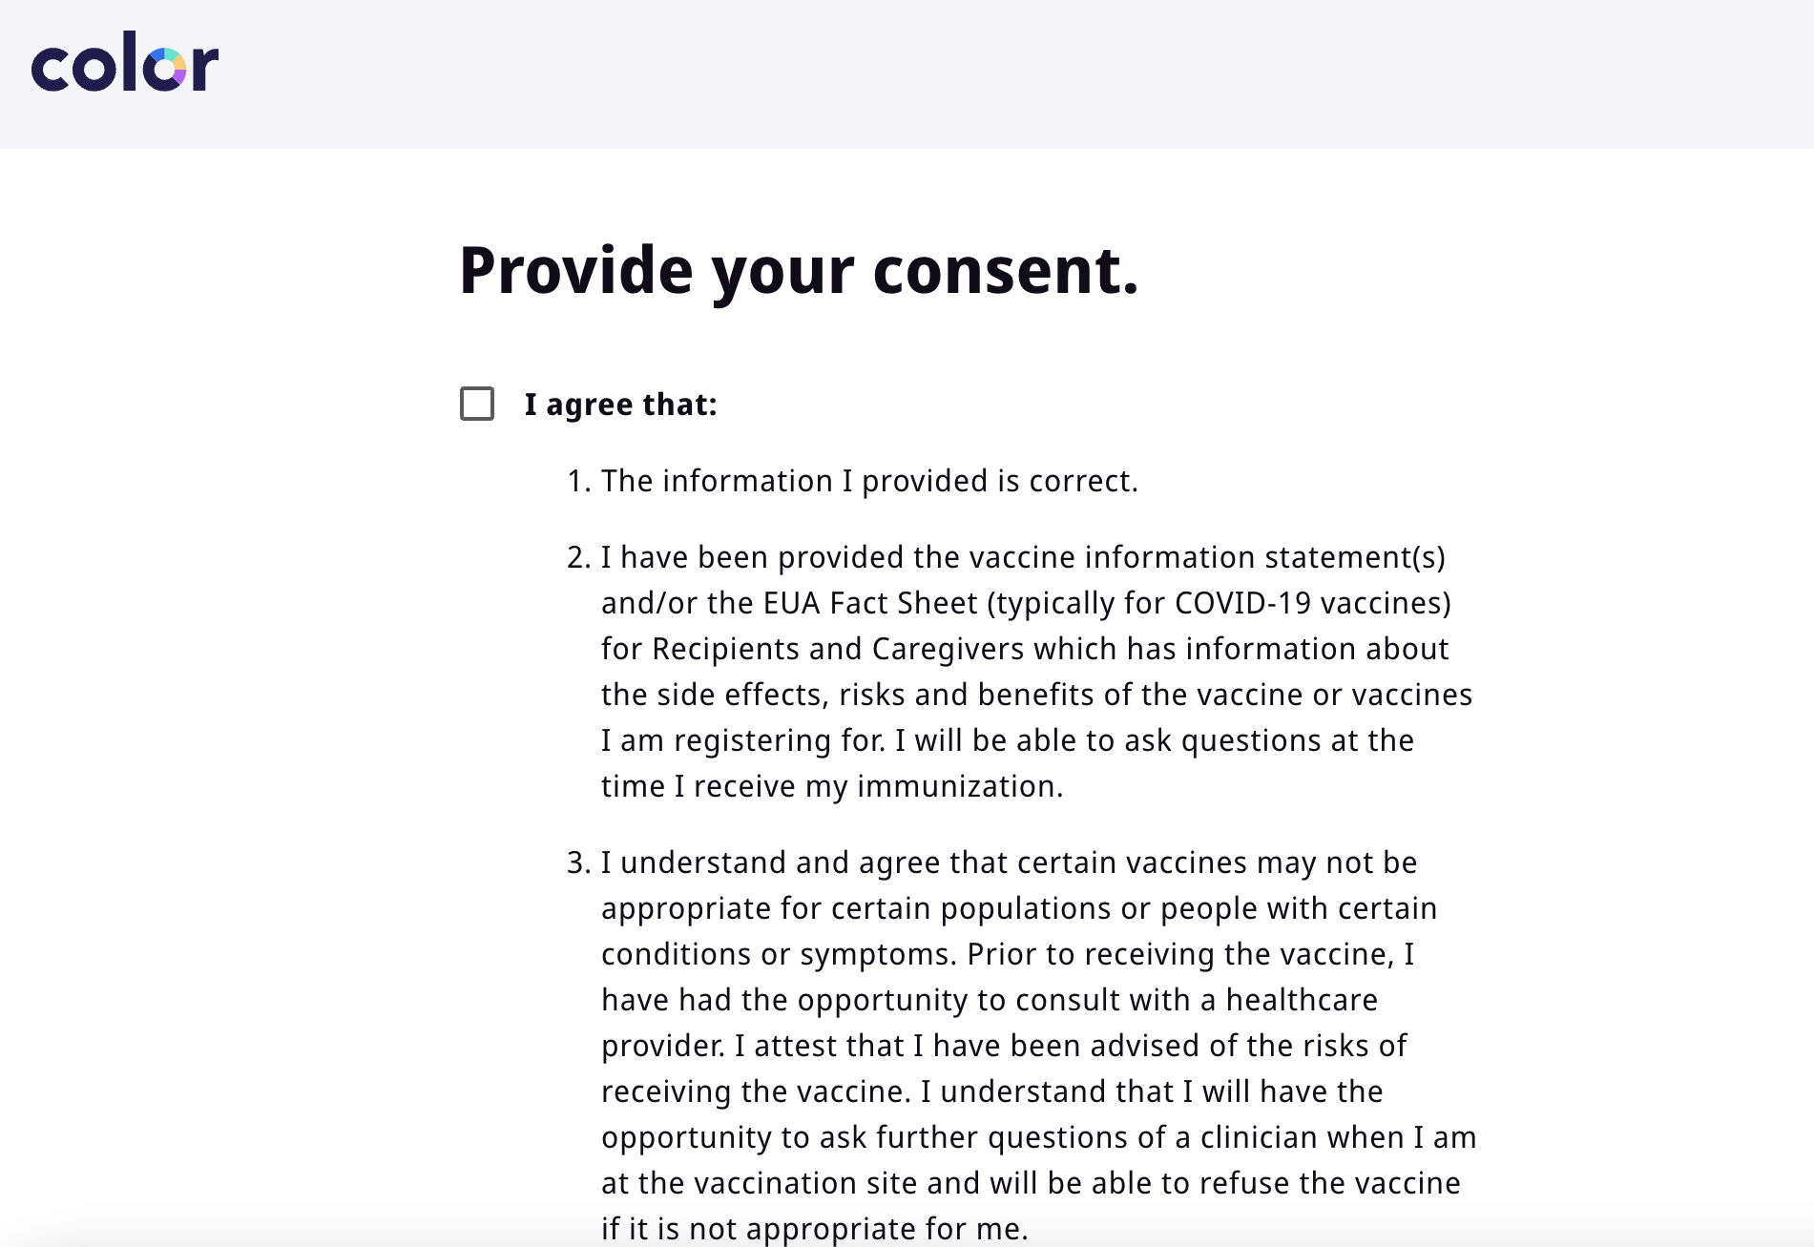
Adding a patient
Adding a patient: Obtain consent from the patient
Hand the device to the patient for them to provide consent.

Slide 14
Adding a patient
Adding a patient: patient is now added and checked in
After you’ve added the patient, you will need to go through and vaccinate them as you would during a live clinic

Slide 15
02
Applications of secondary calendars

Slide 16
Reasons for secondary calendars
Need to reserve appointment availability for a certain group (e.g., community group)
Need to differentiate between different doses of a vaccine (e.g., high-dose v. regular dose flu)
Proprietary and Confidential — Not for distribution.

Slide 17
What a secondary calendar is
What a secondary calendar is not
Protected availability only accessible via a private URL
Those accessing appointment availability via a secondary calendar link also have access to primary calendar availability
Configurable with dose-specific appointments
Hidden vaccination site that only those with the private URL can see
Reserved availability for multiple doses of a multi-dose vaccine (e.g., COVID)

Slide 18
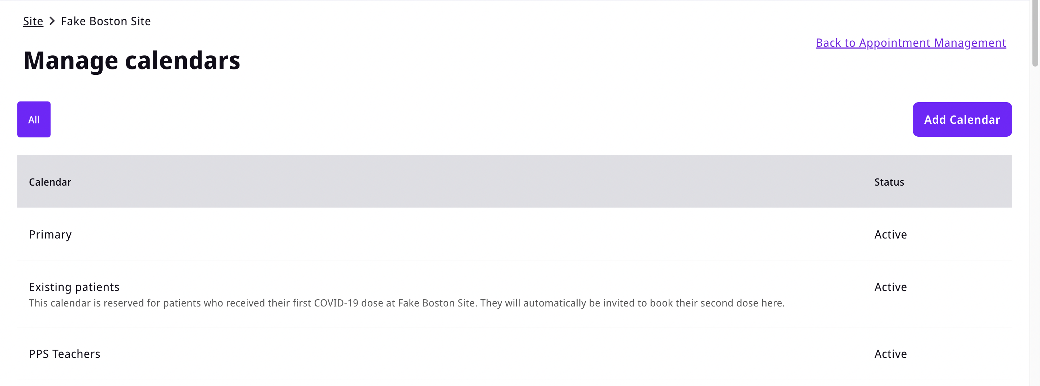
Add a secondary calendar
In addition to the default “Primary” calendar, Site Schedulers can choose to create additional secondary calendars.

Slide 19
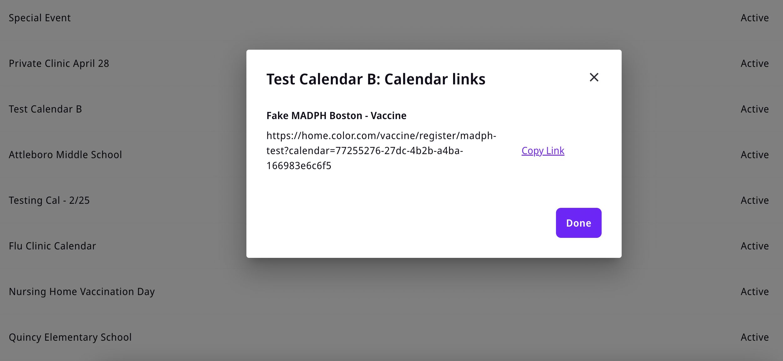
Secondary calendars have a private URL
The URL for this calendar can be shared with others, at the discretion of the site.
Appointments added here are not available for booking through the primary registration path.

Slide 20
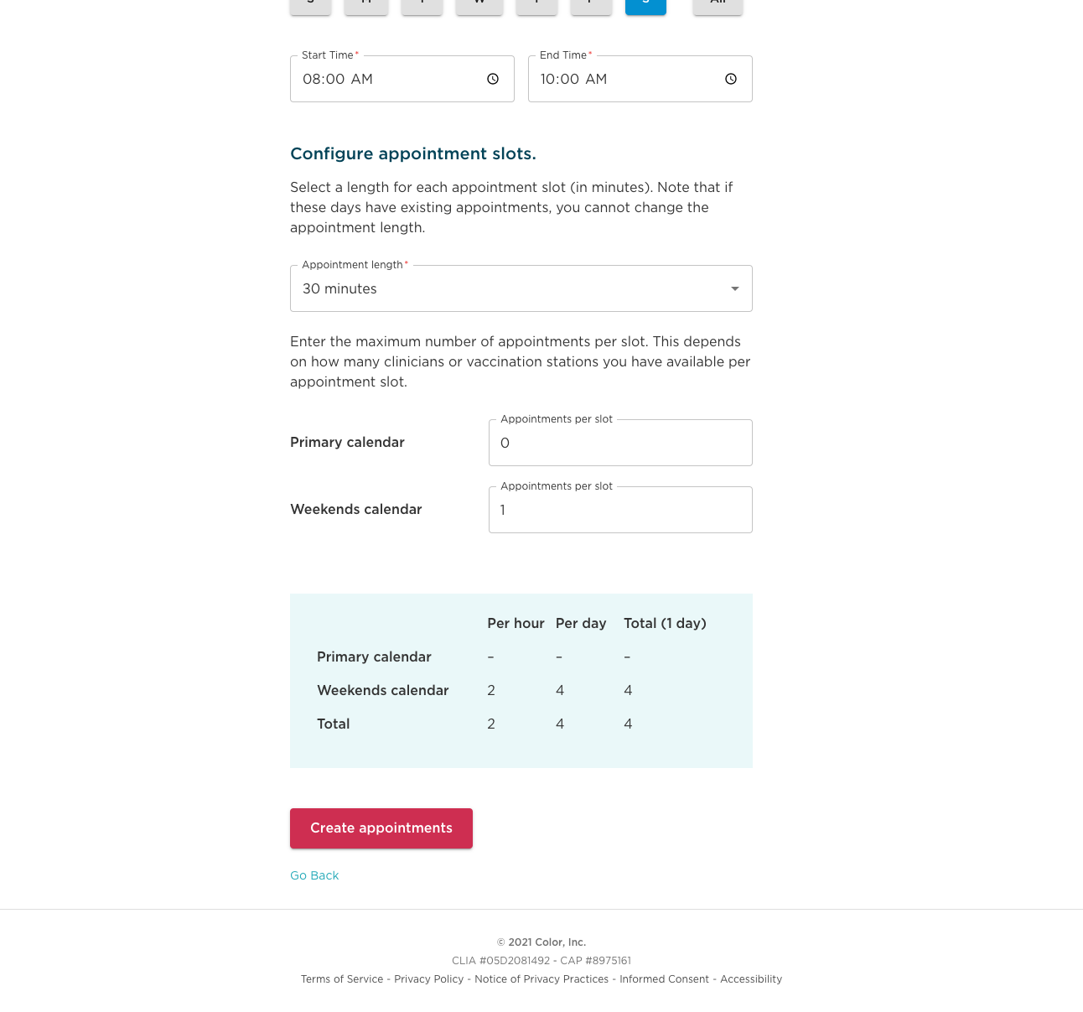
Add appointments to secondary calendar
Site Scheduler can add appointments to a secondary calendar. These appointments will be available for anyone booking through the registration flow using the private URL.
NOTE: Appointments must be added to the correct secondary calendar.
Rescheduling and 2nd dose appointments reserved for current patients will be handled through the primary calendar.

Slide 21
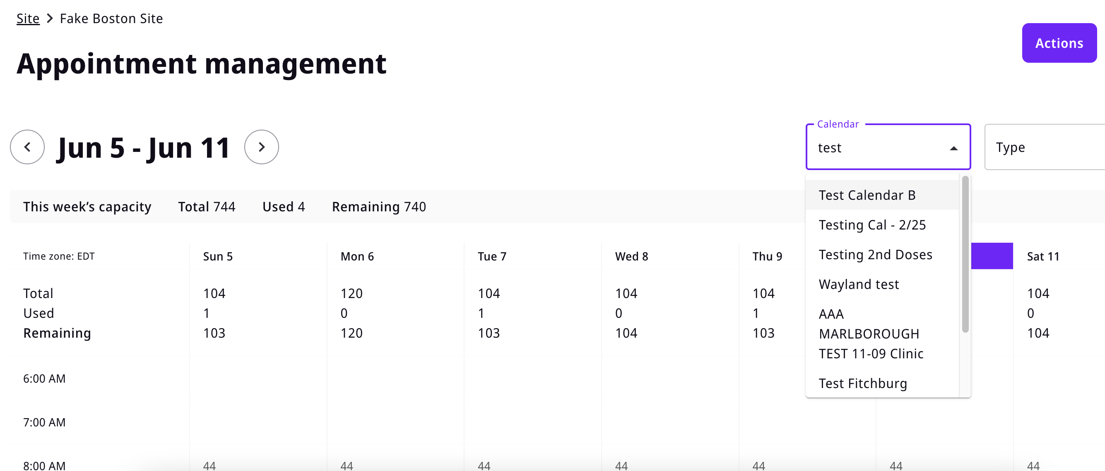
View summary information
You can filter the calendar view to see week / day / hour summary information just for a specific secondary calendar.

Slide 22
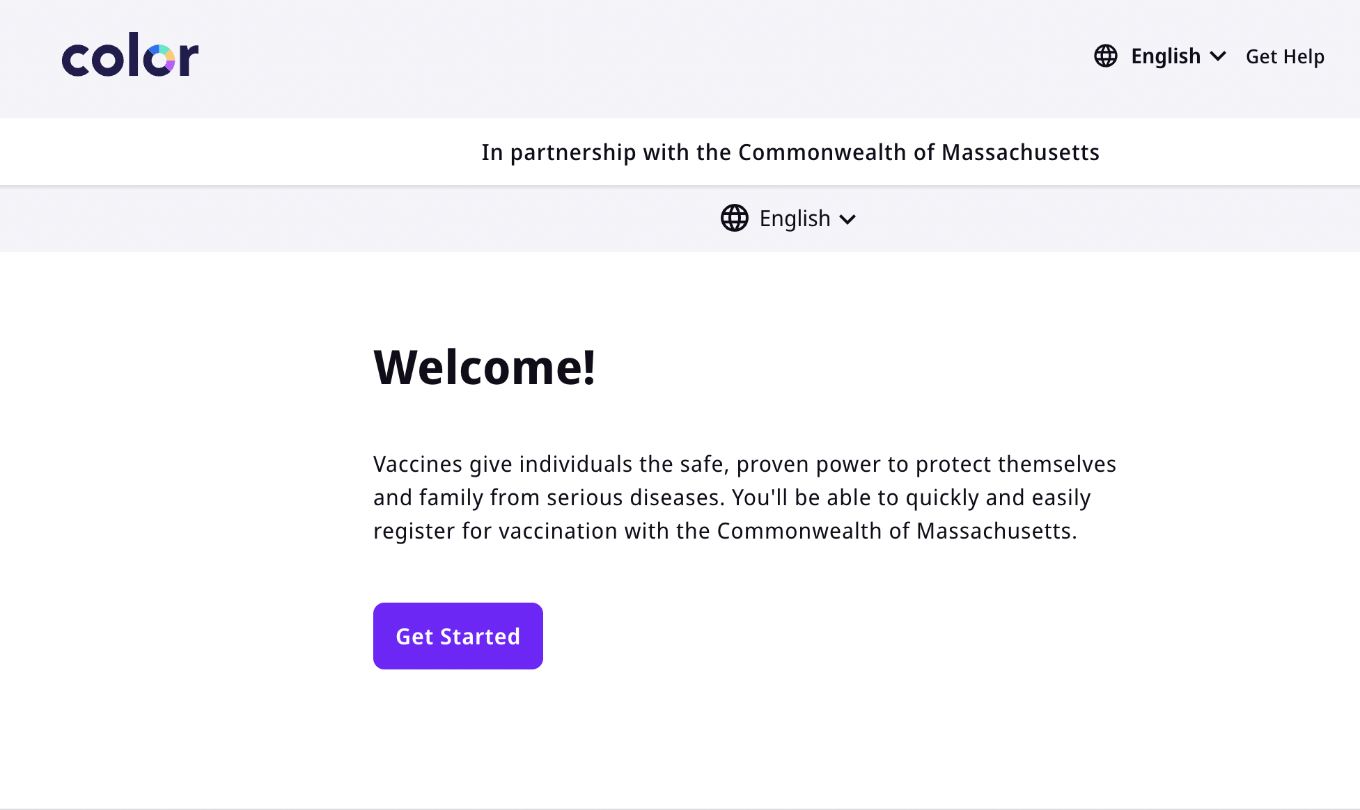
Enter the private URL into a browser
The registration flow that the secondary site’s private URL leads to is the same as that of the primary calendar. The only difference is that only appointments from the secondary calendar are surfaced.
Rescheduling and 2nd dose appointments reserved for current patients will be handled through the primary calendar.

Slide 23
03
Registration deep dive

Slide 24
Color offers several ways to register a patient
Pre-registration links via primary/secondary calendars allow patients to register in advance
Walk-up URL allows patients to self-register for same-day appointments
On-the-spot appointment scheduling allows clinicians to register patients for same-day appointments
Proprietary and Confidential — Not for distribution.

Slide 25
Color offers several ways to register a patient
Pre-registration links via primary/secondary calendars allow patients to register in advance, including the following use cases:
  Distribute through a school email blast
  Post to a town page
  Create your own QR code and create pre-registration fliers
  Share it w/ a senior center staff to either fully or partially register patients in-person/over phone
Proprietary and Confidential — Not for distribution.

Slide 26
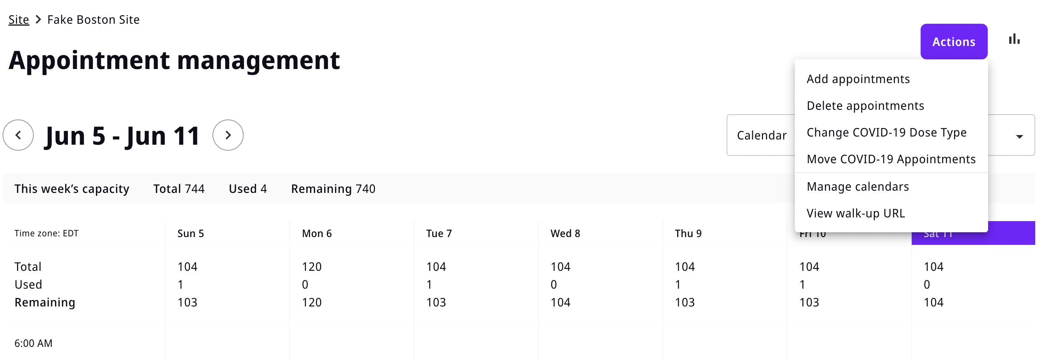
Accessing calendars
URL links are accessible in Appointment management
1. Within Appointment management, click “Actions” in the top right-hand corner
2. Then click on “Manage calendars” from the drop-down view

Slide 27
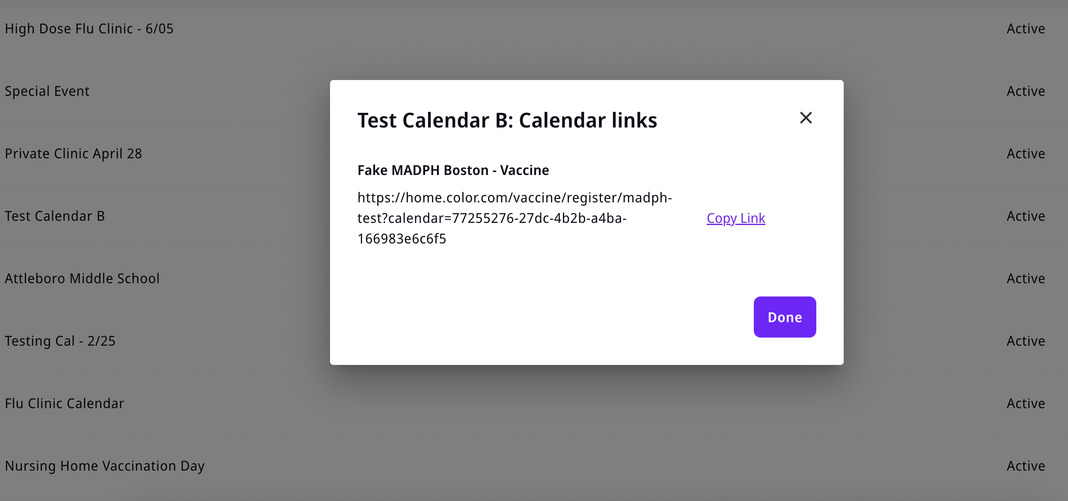
Accessing calendars
URL links are accessible in Appointment management
3. Clicking on the calendar name will bring up a pop-up with that particular calendar’s URL link. If you click “Copy Link” you’ll be able to copy/paste the link to your mobile browser

Slide 28
Color offers several ways to register a patient
Walk-up URL allows patients to self-register for same-day appointments
  Copy QR code from Color and post it at clinic entrance
  Print out walk-up URL and post at clinic entrance
Proprietary and Confidential — Not for distribution.

Slide 29
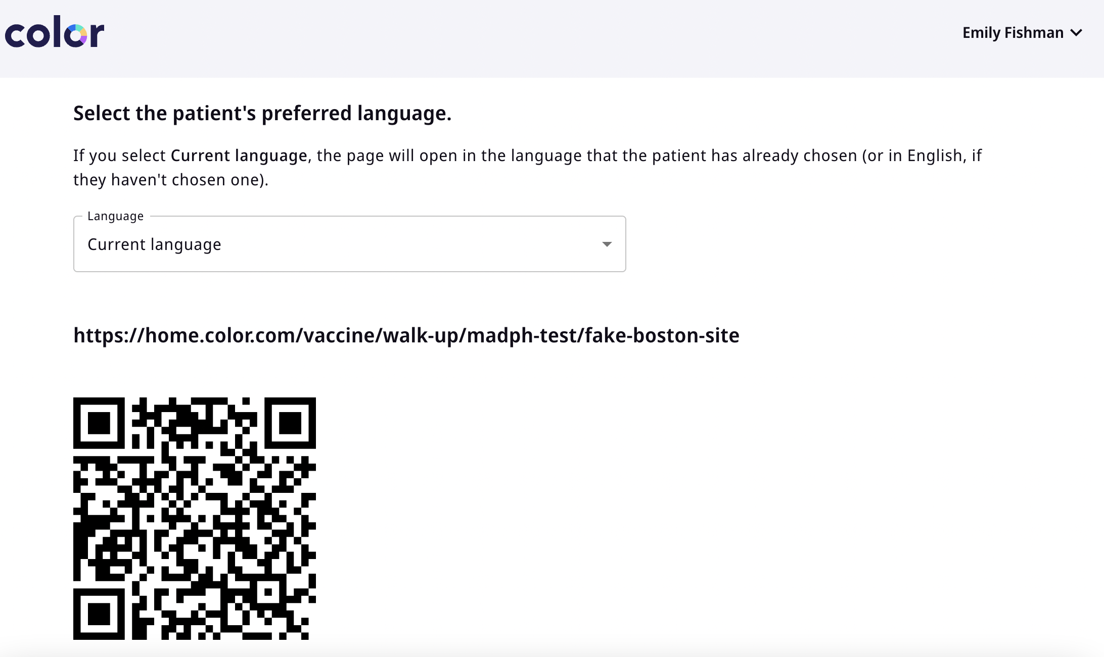
Walk-up self registration
Another way to add a patient
Go to appointment manager
Under actions, click ‘view walk-up URL’
Select language
Share or print URL or QR code
Patient will get dropped into regular scheduling flow from either
Once patient has completed registration, they will show up in the onsite tool to be checked in and vaccinated.

Slide 30
Color offers several ways to register a patient
On-the-spot appointment scheduling allows clinicians to register patients for same-day appointments
Proprietary and Confidential — Not for distribution.

Slide 31
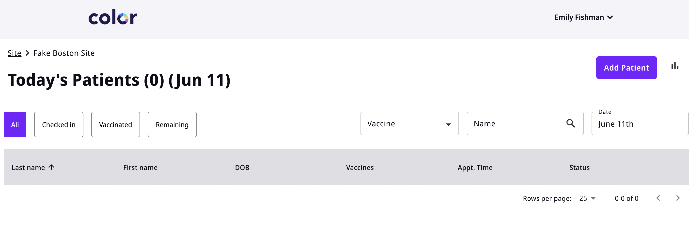
Adding a patient
Adding a patient: click on add patient
Selecting the “Add Patient” link will initiate the process for adding a new patient.

Slide 32
Adding a patient
Adding a patient: collect patient information
Collect required patient information.

Slide 33
Adding a patient
Adding a patient: provide vaccination history
If patient has had a previous vaccination, ask them for the manufacturer and dose.
If the patient hasn’t waited an appropriate number of days since their previous dose, the system will show they are not eligible.

Slide 34
Adding a patient
Adding a patient: confirm patient contact information
Make sure the information entered is correct, as contact info and DOB will be used for scheduling reminders and access to booking their second dose appointment.

Slide 35
Adding a patient
Adding a patient: complete the prevaccination checklist with the patient

Slide 36
Adding a patient
Adding a patient: Collect their health insurance
Patients have the ability to add a primary and secondary insurance with “Yes, I have multiple insurance plans”

Slide 37
Adding a patient
Adding a patient: Obtain consent from the patient
Hand the device to the patient for them to provide consent.

Slide 38
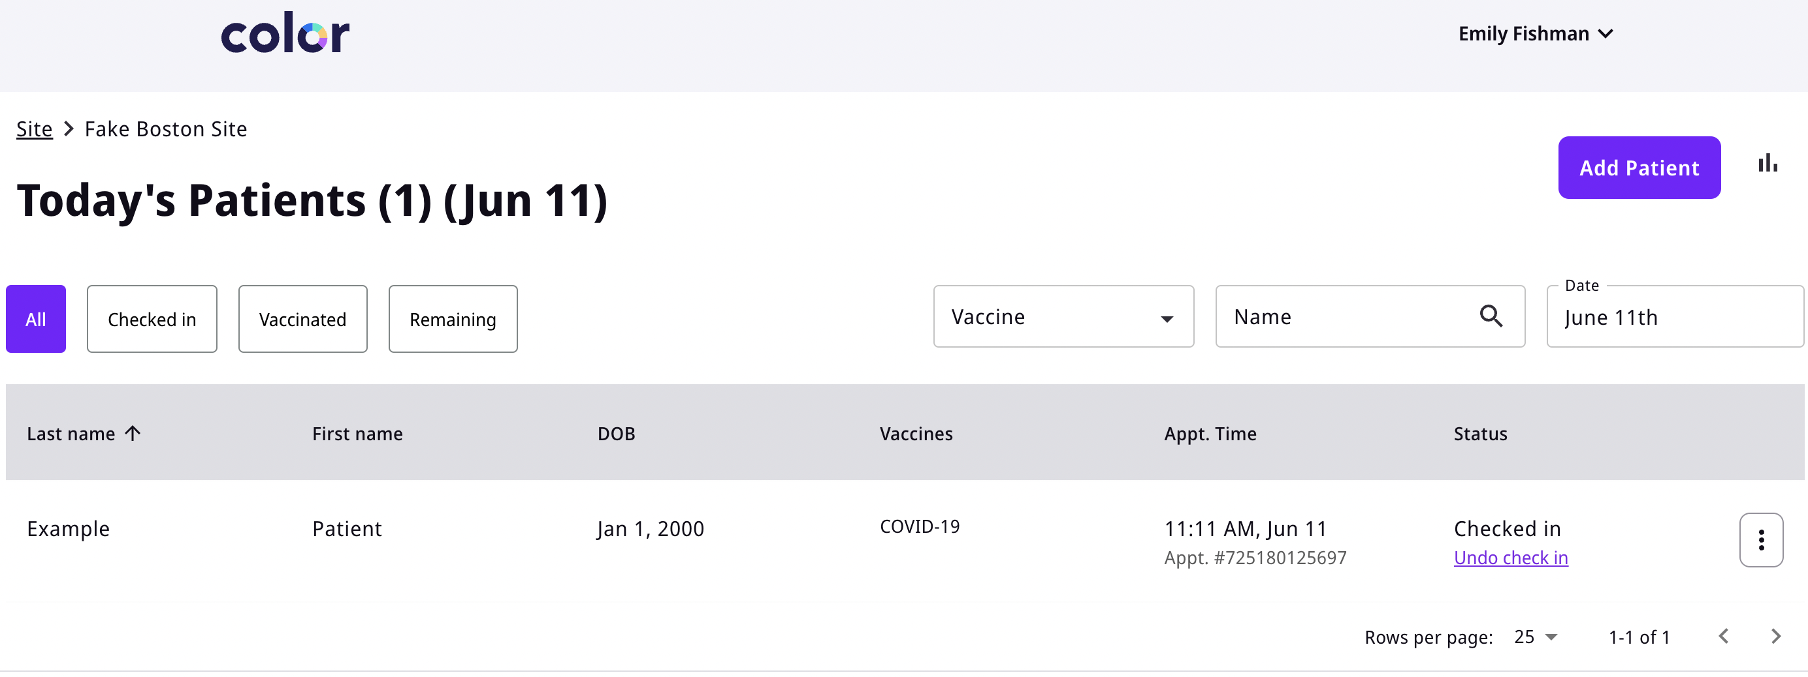
Adding a patient
Adding a patient: patient is now added and checked in

Slide 39
04
Retroactively entering registration and vaccination data

Slide 40
Reasons for retroactively adding data
Loss of or limited/no wifi in service area
Need to maintain high throughput and insufficient clinicians to assist with registration/check-in process
Proprietary and Confidential — Not for distribution.

Slide 41
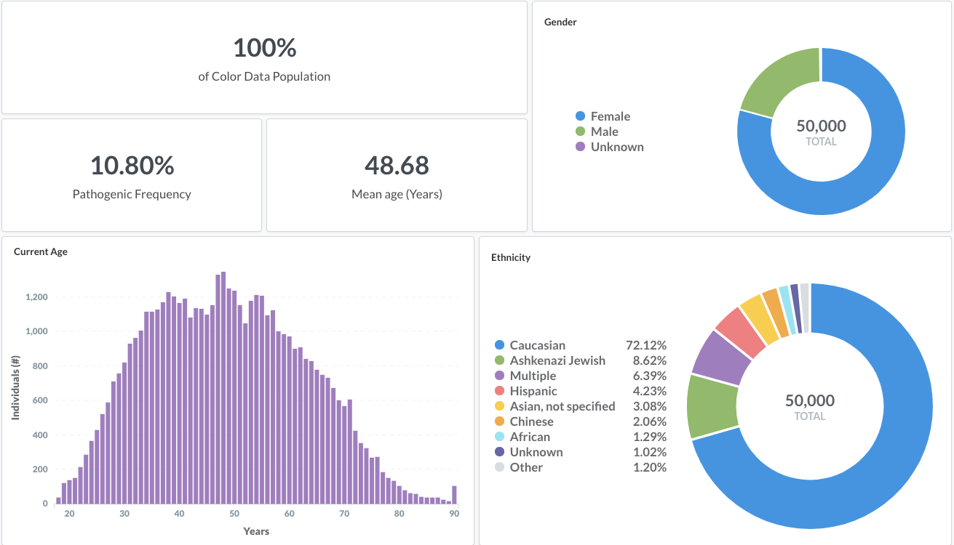
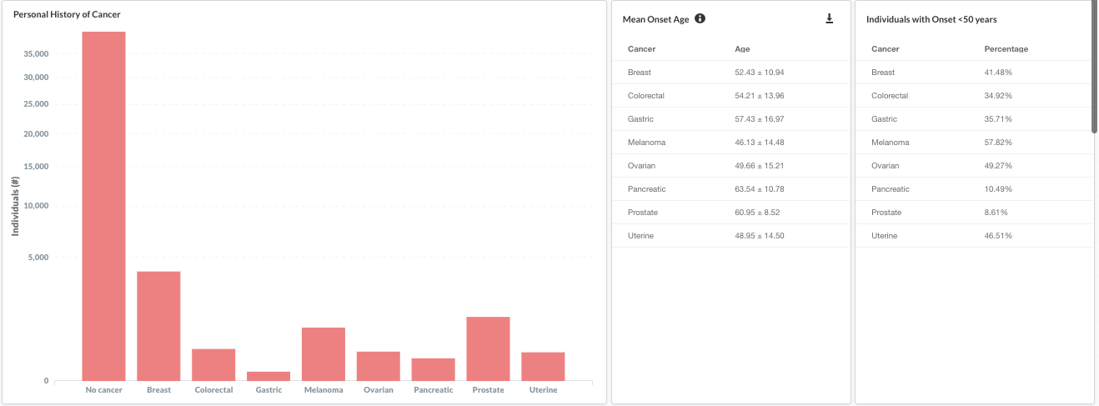
Steps for retroactively adding data
Use the “Add patient” functionality in the Vaccination section of the Onsite tool to add patient details and vaccinate
Edit patient details to correspond to actual date of vaccination

Slide 42
Steps for retroactively adding data
Use the “Add patient” functionality in the Vaccination section of the Onsite tool to add patient details and vaccinate

Slide 43
Adding a patient
Select the vaccination tool within the Onsite tool

Slide 44
Adding a patient
Adding a patient: click on add patient
Selecting the “Add Patient” link will initiate the process for adding a new patient.

Slide 45
Adding a patient
Adding a patient: collect patient information
Collect required patient information.

Slide 46
Adding a patient
Adding a patient: provide vaccination history
If patient has had a previous vaccination, ask them for the manufacturer and dose.

Slide 47
Adding a patient
Adding a patient: confirm patient contact information

Slide 48
Adding a patient
Adding a patient: complete the prevaccination checklist

Slide 49
Adding a patient
Adding a patient: Collect their health insurance
Patients have the ability to add a primary and secondary insurance with “Yes, I have multiple insurance plans”

Slide 50
Adding a patient
Adding a patient: Note consent received from the patient

Slide 51
Adding a patient
Adding a patient: patient is now added and checked in
After you’ve added the patient, you will need to go through and vaccinate them as you would during a live clinic

Slide 52
Steps for retroactively adding data
Edit patient details to correspond to actual date of vaccination
Site Staff or Vaccine Clinicians will be able to edit a patient's vaccination record after a vaccine has occurred
Because this will trigger an update to immunization records, it is important site staff are well informed of this feature.

Slide 53
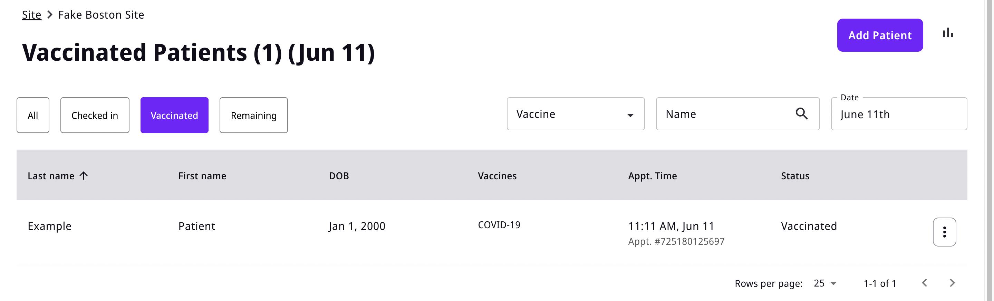
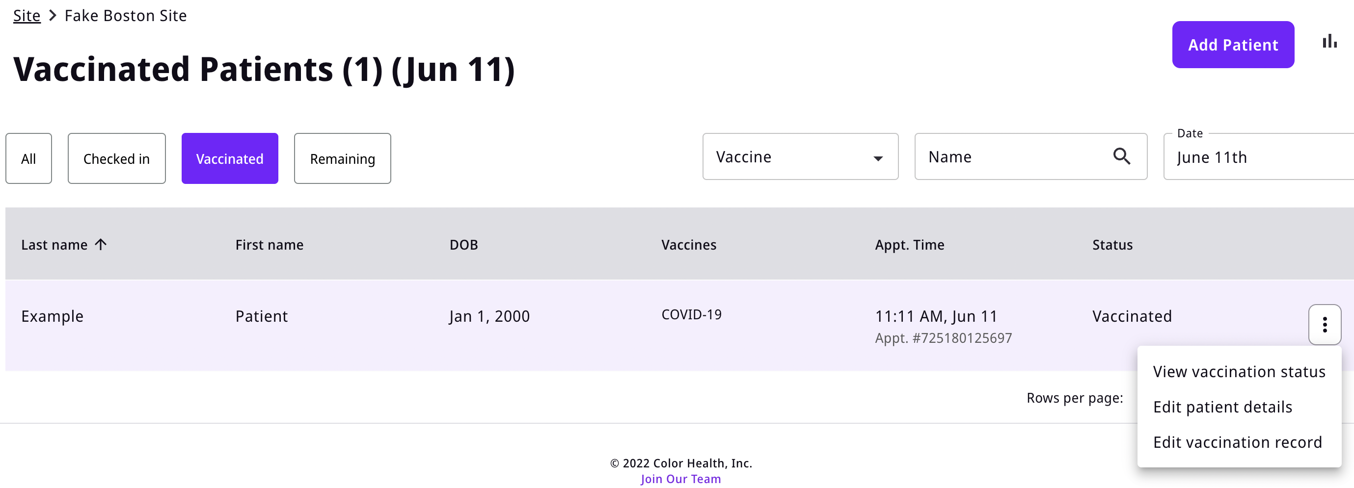
Making an Edit
Editing a record
Select participant under vaccinated tab
2. Select the three dots to the right of the status “Vaccinated” and select “Edit vaccination record”

Slide 54
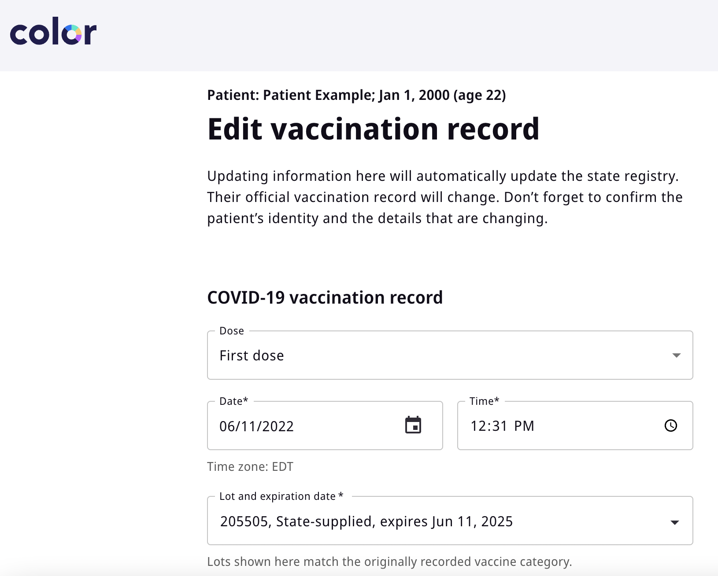
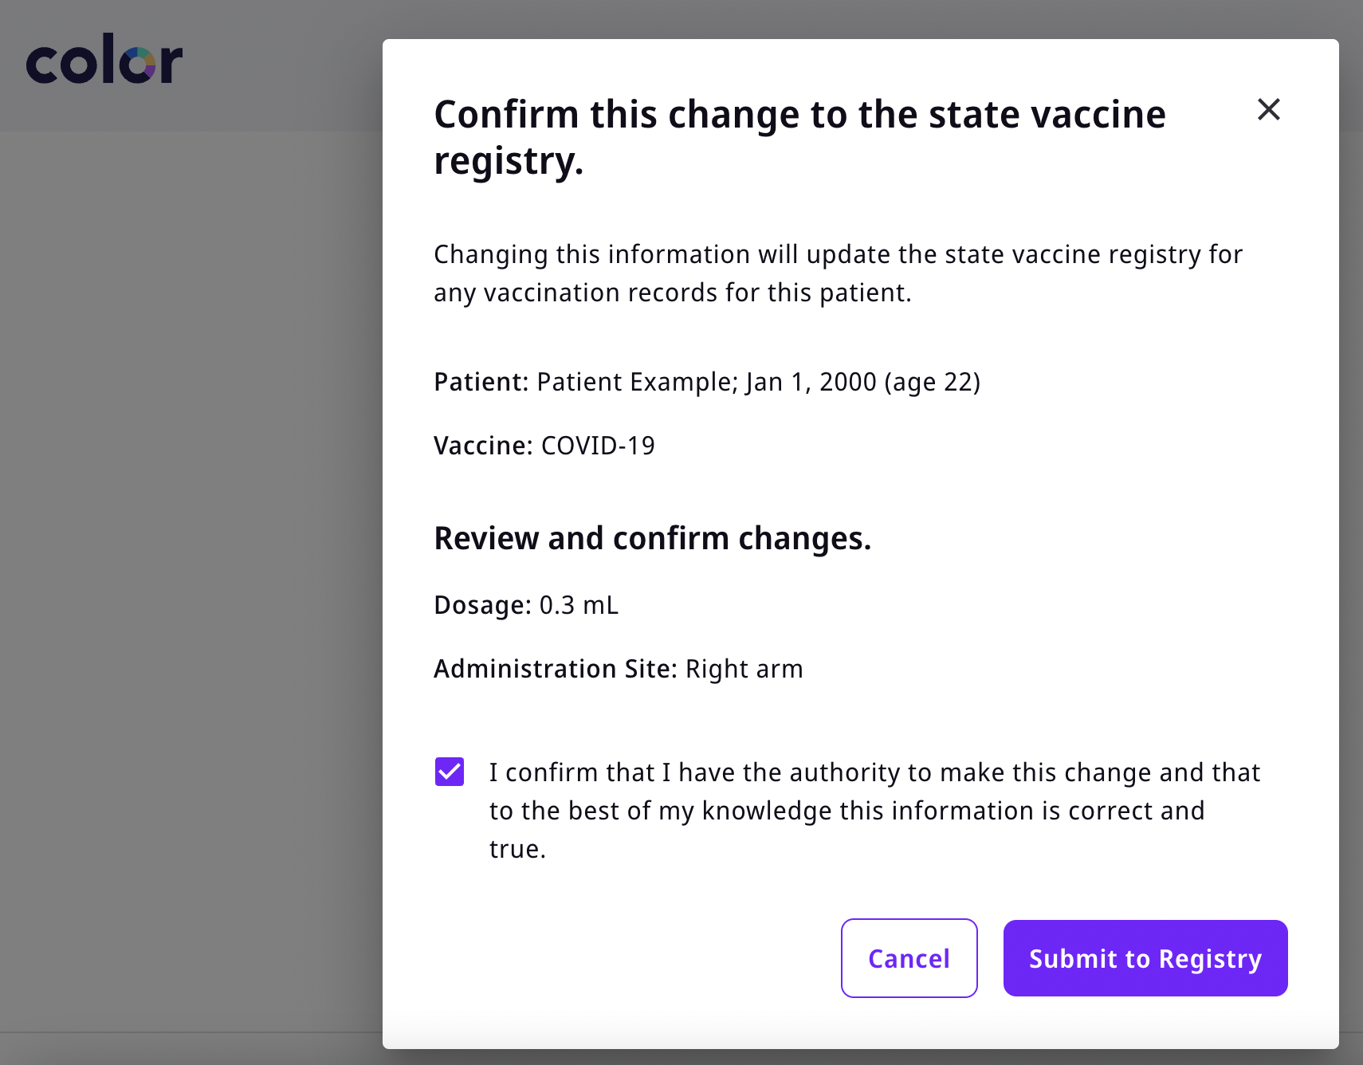
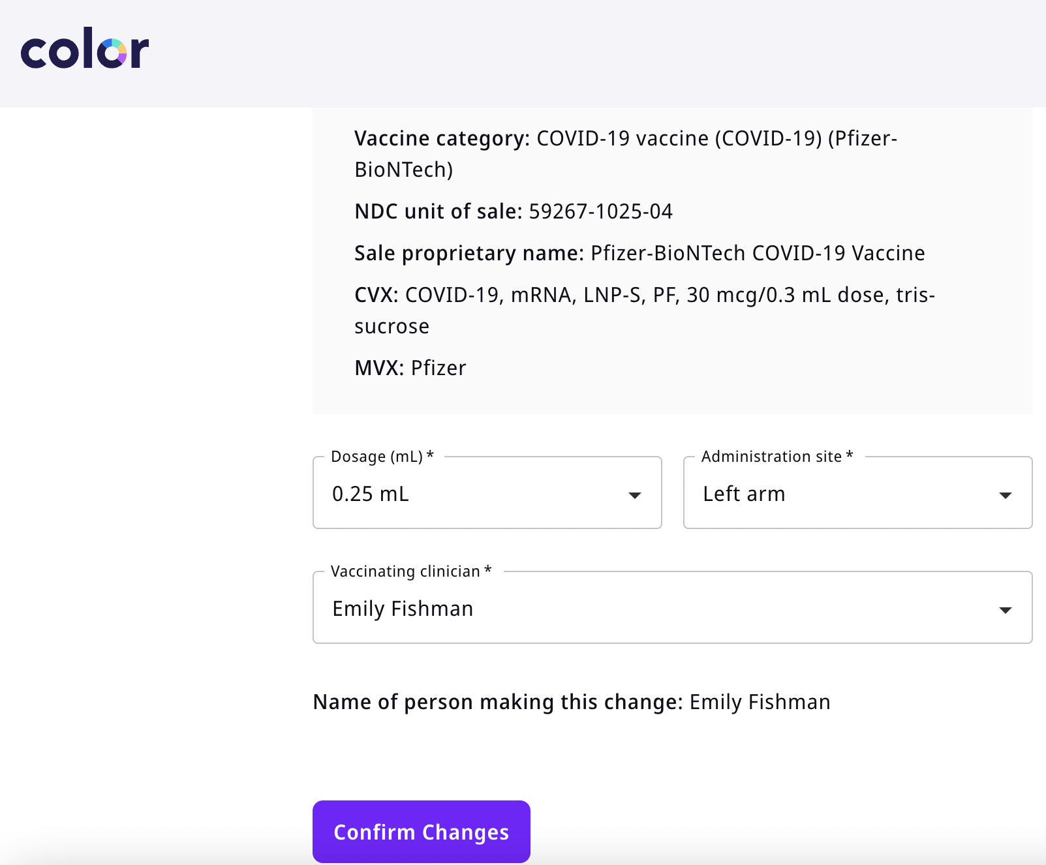
Making an Edit
Editing a record
3. Edit the vaccination record
4. Review and confirm changes

Slide 55
05
Scribe feature

Slide 56
Reasons for scribe feature
Loom video
Need to use scribes during clinical workflow but correctly reflect the vaccinating clinician in MIIS
Proprietary and Confidential — Not for distribution.

Slide 57
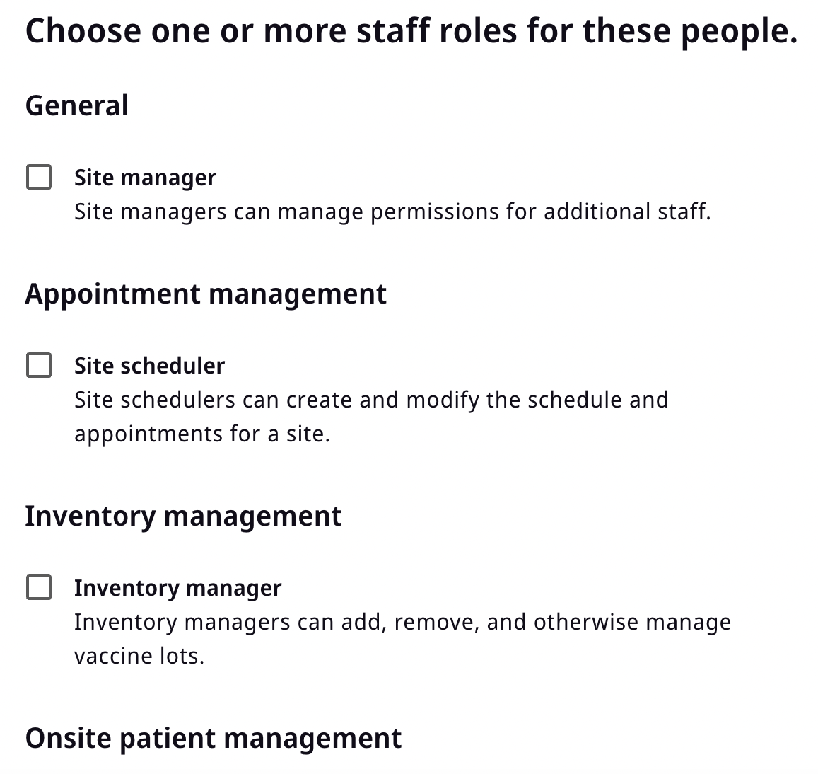
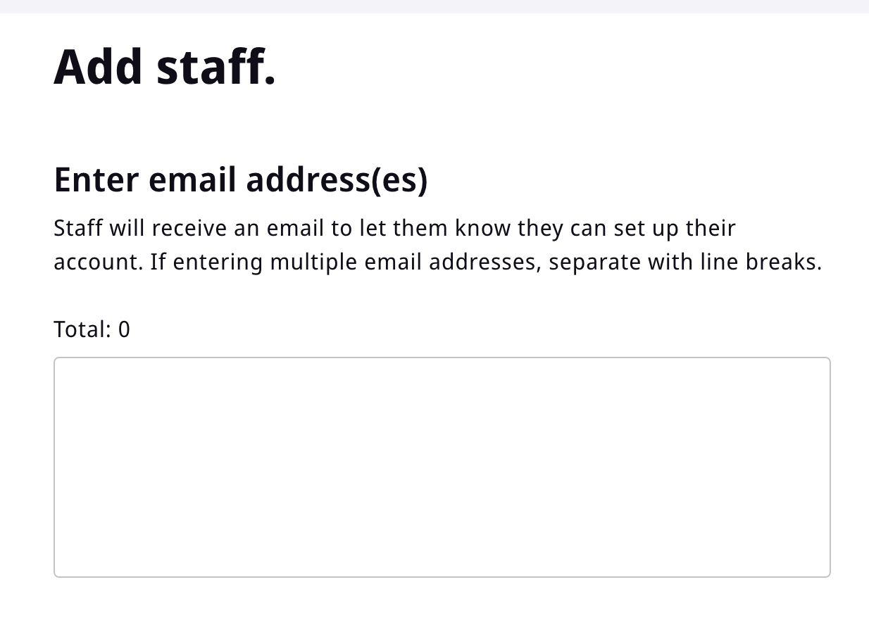
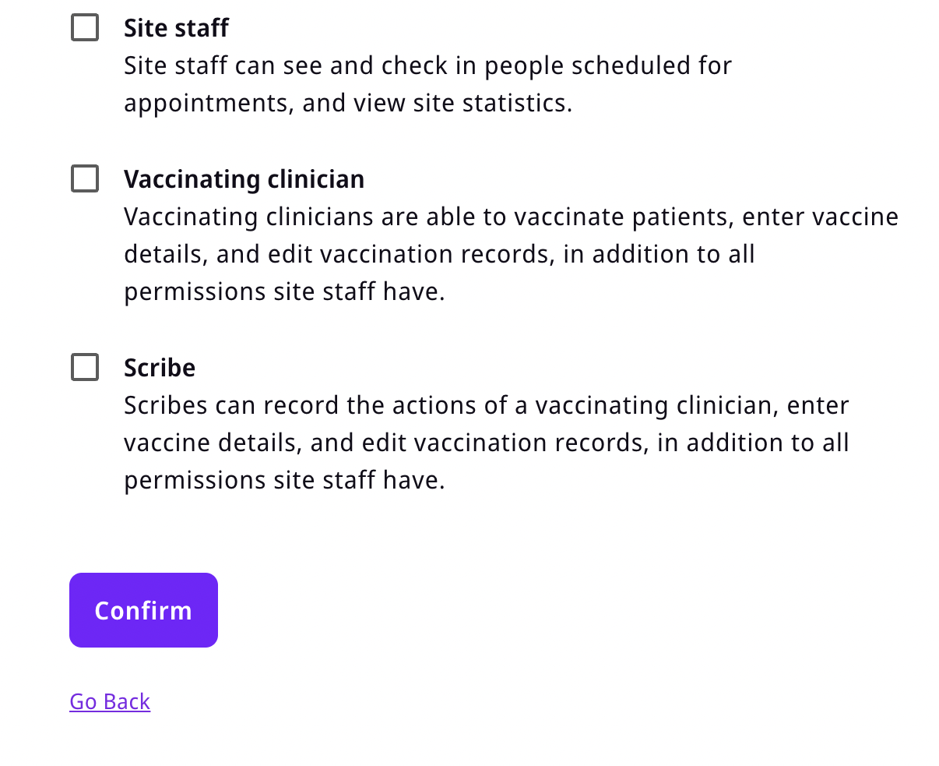
Adding a Scribe
3. Choose staff roles and select Scribe.
1. Using the Staff Management Tool, select
“Add Staff” in the top right hand corner.
2. Enter the staff member’s email address.

Slide 58
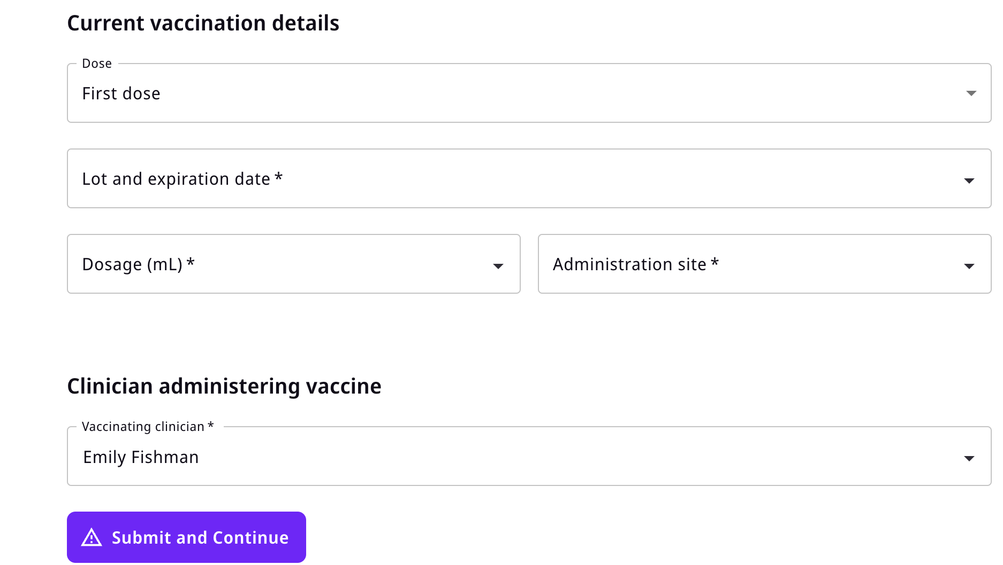
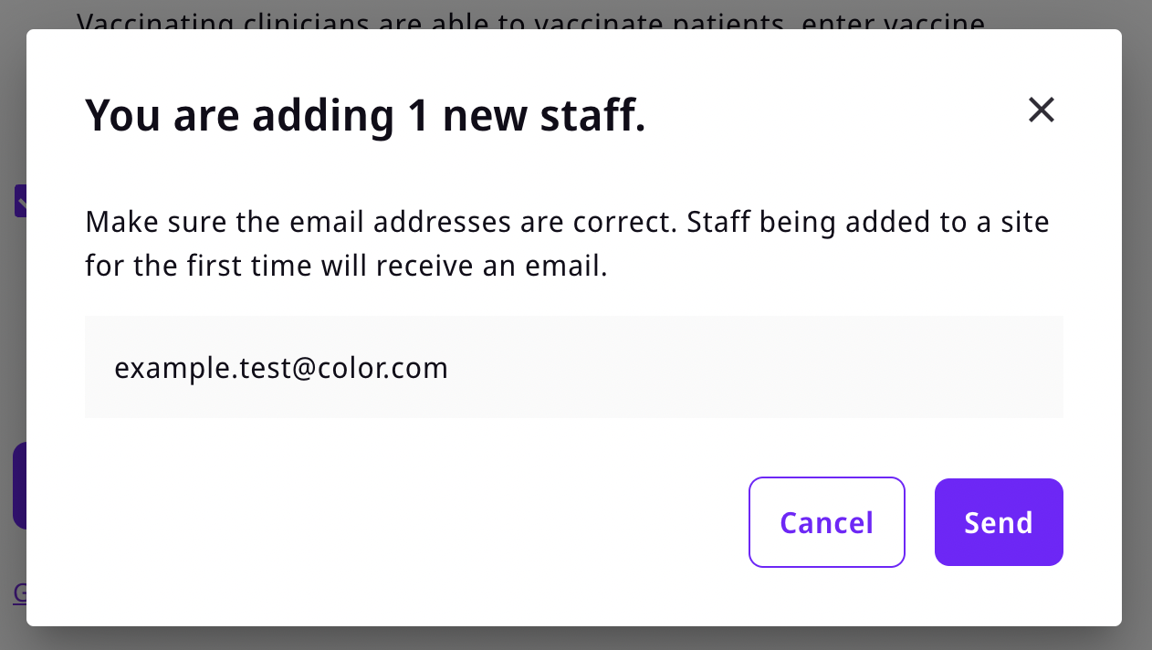
Editing a record
4. Confirm the staff member’s email and the role(s)
selected.
5. Make sure staff members have set up their accounts.
6. When vaccinating, select the correct vaccinating
clinician using the dropdown option.

